Slide 1

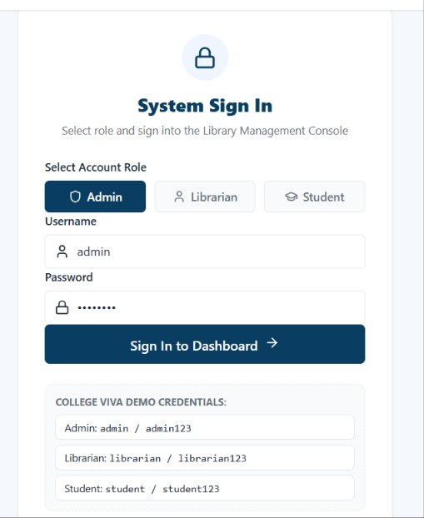
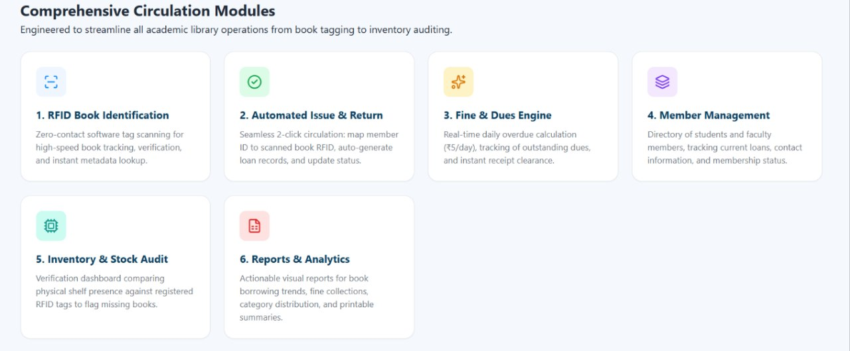

KLH Logo
LIBRARY MANAGEMENT WITH RFID INTEGRATION66
Team ID: 20 | Section: S-12 | Members: B.Siddhartha - 2500090225 | Jaswanth Reddy – 2520080025 | V.Santosh – 2520090051 | Guide: Khaja Shareef
Database Systems Engineering and Distributed Backend Development (25CS1302E) | KLH Bachupally Campus, CSE | PBL 2026-27
Abstract
Tools & Technologies
A secure and scalable library system that connects RFID-based bookhandling with a centralized digital database. It supports automatedissue/return, real-time inventory, transaction history, finecalculation and role-based access.Outcome: less manual work, faster circulation and more accuratelibrary records.
Front-End: Web interface
Back-End: Node.js + REST API
Databases: MySQL + MongoDB
RFID: Tags + Reader
Communication: MQTT / WebSockets
Tools: VS Code, MySQL, MongoDB
Problem Statement & Objectives
Problem: Manual issue/return and inventory checking can cause delays,inaccurate tracking, duplicate records and missed overdue books.
Objective 1: Automate issue and return using RFID.
Objective 2: Centralize books, members, tags and transactions.
Objective 3: Track availability and inventory in real time.
Objective 4: Calculate overdue fines and support role-based access.
Scope: Admin/Librarian and Student/Member modules, bookmanagement, transactions and reports.
System Architecture
RFID TAG → RFID READER → REST API / APPLICATION → DATABASE
↓
ISSUE / RETURN / INVENTORY
↓
LIBRARIAN / ADMIN + STUDENT
Existing vs Proposed System
Feature | Existing System | Proposed System
Issue / Return | Manual entry | RFID-assisted issue & return
Book Tracking | Manual checking | Live RFID + DB status
Records | Scattered / Manual | Centralized MySQL database
Overdue / Fine | May be missed | Due-date tracking + fine calculation
Security / Access | Limited role control | Role-based access for users
ER Diagram & Database Design
Core entities:
STUDENT • BOOK • AUTHOR • CATEGORY • LIBRARIAN • ISSUE_RETURN • FINE
Key relationships: Student → Issue_Return; Book → Issue_Return; Librarian →Issue_Return; Issue_Return → Fine.
MySQL database: rfid_library.
Feasibility Study
Technical: Node.js, REST API, MySQL, MongoDB, RFID reader/tags.
Economic: Uses common/open-source software and existing lab infrastructure.
Operational: Simple role-based workflow for librarians and students.
Schedule: Designed for completion and demonstration within the semester.
Implementation Screenshots
[Screenshot 1]
[Screenshot 2]
Results & Testing
Conclusion
Future Scope
RFID search, issue, return, availability, overdue, fineand transaction-history queries are implemented inMySQL.Testing covers CRUD operations, joins, status updatesRFID lookup and report generation.
The proposed system connects physical RFID scanswith a centralized library database.It supports faster circulation, accurate inventory,transaction tracking, fine management and controlledaccess.
Mobile integration.
Self-service RFID kiosks.
Entry/exit tracking.
Email & SMS alerts
. Online reservations.
References: Project PPT | Project Abstract Submission Form | MySQL Database Script
Course: Database Systems Engineering and Distributed Backend Development (25CS1302E) | PBL 2026-27
QR: GitHub

